Slide 1
DATA ANALYTICS PROJECT
UNIVERSITY HR ANALYTICS
A Power BI dashboard for exploring staff, salary,
department and publication records
SUNDAY OBIOMA
Data Analyst | Power BI & SQL

Slide 2
Project Overview
Turning university workforce data into a clearer management view
Project objective
Questions explored
Intended audience
Summarize staff numbers, salary distribution, departmental patterns and recorded publications in one interactive report.
How is salary distributed across departments and qualifications? Which departments and qualifications have higher recorded publication totals?
University administrators, HR teams and decision-makers who need a high-level view of workforce and recorded academic output.
Scope
This is a descriptive analysis of the available dataset. It highlights patterns in the recorded data; it does not, by itself, explain the causes of salary differences or publication output.
2

Slide 3
Dataset & Preparation
Power Query was used to prepare the data for analysis
16 columns
Power Query
2,000 records
Rows in the prepared University HR Analytics table.
Fields covering staff, departments, salary, qualifications and publication-related information.
Used for text cleanup, type changes, value replacement and error handling.
Preparation steps documented
Data-quality note
• Promoted headers and assigned data types
The cleaning log identified 880 missing values in publication and specialization fields at the checked stage. Missing publications were replaced with 0, while missing specialization was labeled “unknown”. These choices should be disclosed as assumptions when interpreting results.
• Trimmed and cleaned text fields
• Replaced selected errors and inconsistent values
• Handled missing publication values and unknown specialization
3

Slide 4
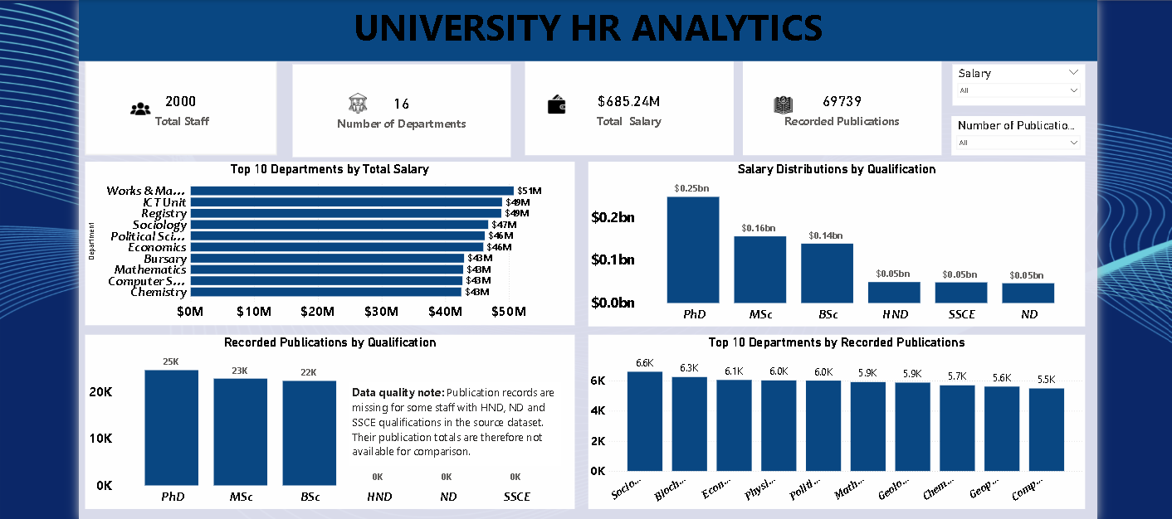
Dashboard Overview
The project’s existing Power BI report
Dashboard photo supplied by the project owner; chart labels are shown as captured.
4

Slide 5
Headline Metrics
2,000
16
685.24M
69,739
Total staff
Departments
Total salary
Recorded publications
Interpretation: these are descriptive totals from the report. The salary unit/currency should be stated explicitly in the final portfolio only after it is confirmed from the source dataset.
5

Slide 6
What the Dashboard Helps Explore
Department salary comparison
Qualification patterns
The Top 10 department chart helps identify where the largest recorded salary totals sit and supports follow-up review of staffing and payroll allocation.
Salary and recorded publications can be compared across qualification groups to spot differences that may need contextual review.
Department publication totals
Interactive filtering
The Top 10 chart provides a starting point for checking how recorded publication counts vary by department.
Salary and publication dropdown slicers allow users to narrow the view and explore how the displayed charts change under selected filters.
Caution: publication totals reflect what was recorded in the dataset, not necessarily the complete output of every staff member.
6

Slide 7
Recommendations & Next Steps
Confirm the currency and salary period (for example, annual or monthly) before publishing the salary total.
1
Validate salary units
Review missing records
Check the original HR source for the 880 missing publication/specialization values; retain the cleaning assumption in the report.
2
Add context to comparisons
Compare departments using staff counts and relevant staffing context, not salary totals alone.
3
4
Improve future reporting
Maintain consistent department and qualification labels, and define a standard process for updating publication records.
Conclusion: the dashboard provides a consolidated starting point for workforce and recorded-publication review.
7

Slide 8
THANK YOU
University HR Analytics
A data-driven view of staff, salary distribution,
departments and recorded publications
POWER BI • POWER QUERY • DATA ANALYSIS

